Slide 1

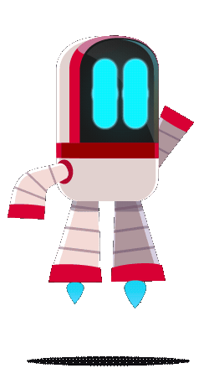

Flexi
CareCode
Flexi
Personalized care, anytime, anywhere.

Slide 2


Flexi
Problems:
Common issue: Over 80% of people suffer from postural problems in Egypt alone.
Modern lifestyle impact: Increased screen time and prolonged sitting worsen posture problems.
Lack of Awareness: Many remain unaware of proper posture, leading to undiagnosed and untreated issues.
80%
Source: Youm7

Slide 3
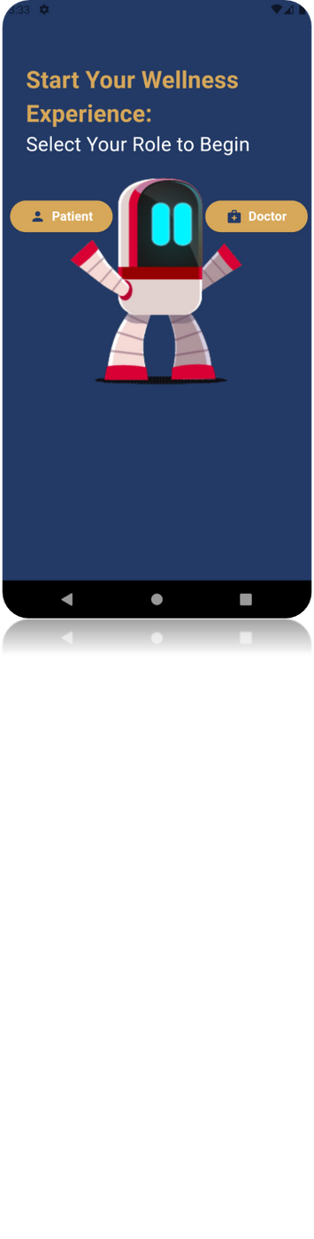


Flexi
Our App
Flexi
An App that combines telemedicine and AI to diagnose postural deformities.

Slide 4
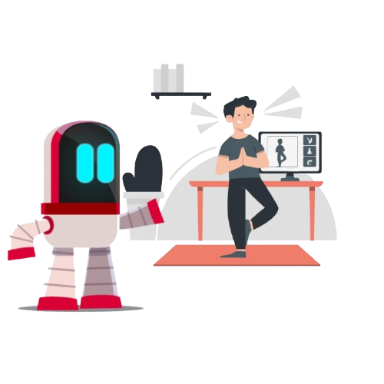

Flexi
User Journey in 3 steps:
Take pictures in certain positions.
AI analyzes images and identifies postural problems.
Based on the results, The app suggests suitable exercises.

Slide 5

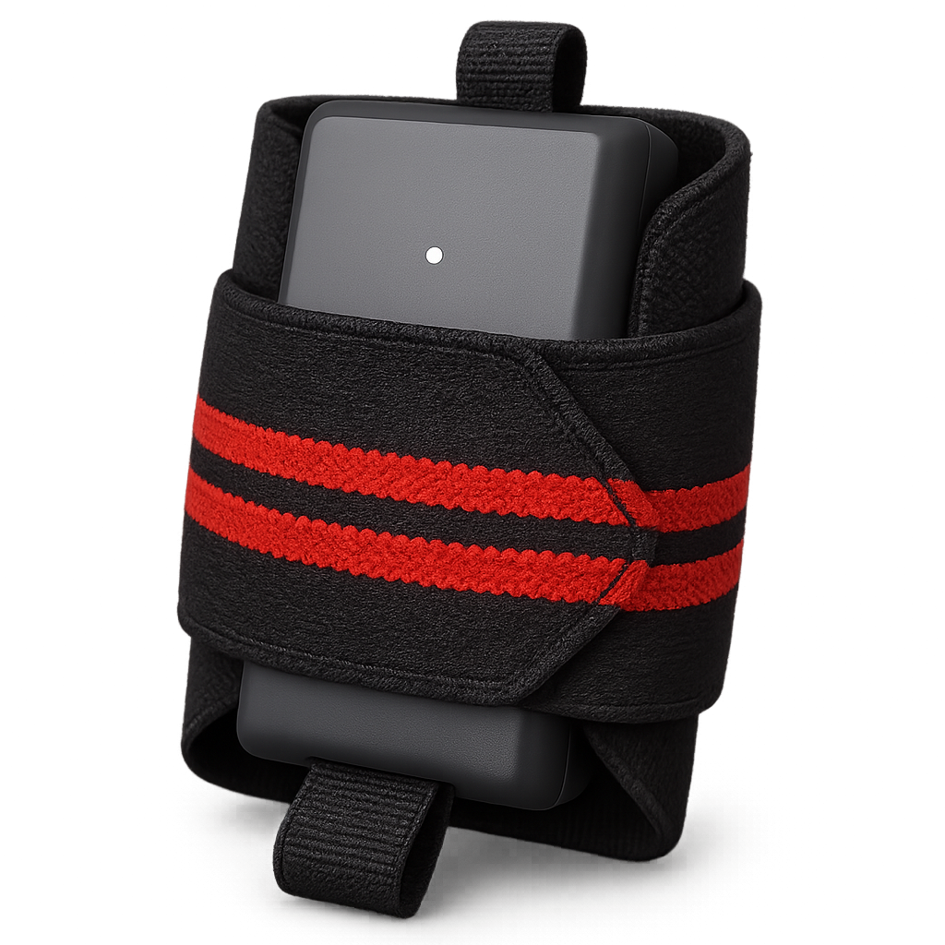
Flexi
Flexi Device:
Flexi comes with a set of wearable devices connected to it, helping the patient even more.
Wearable devices on different body parts based on the exercise
Real-time motion data sent to a central hub
Instant posture & movement correction notifications
Progress reports & exercise improvement suggestions via the app

Slide 6
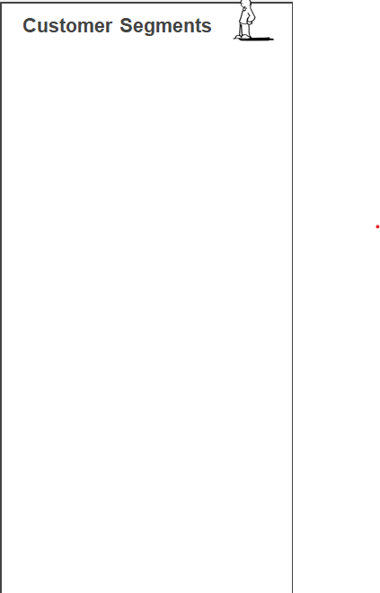
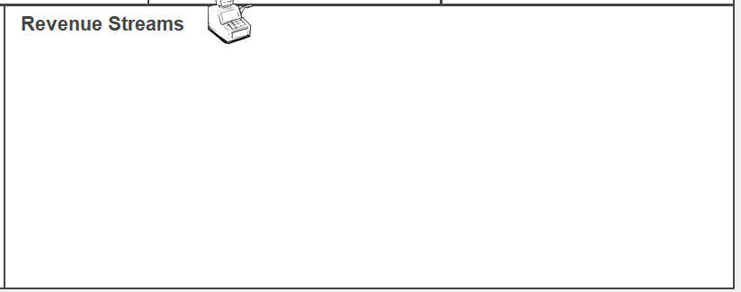
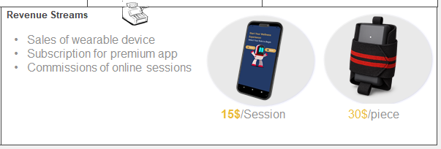
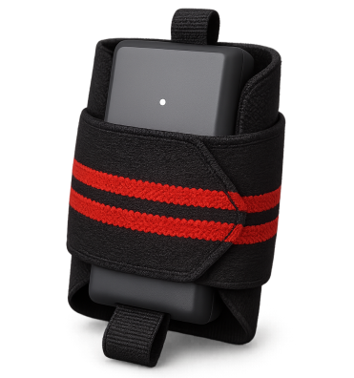
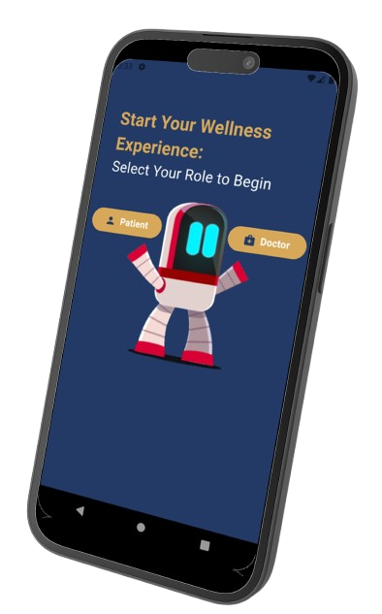
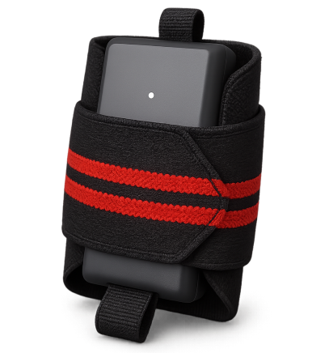
Physical therapy clinics
Fitness centers and gyms
Hardware manufacturer
Fitness influencers
Real time coaching
AI-Detecting posture problems
AI-Suggesting exercises
Generate performance reports
Remote video sessions
Accurate, AI driven posture assessment reports and exercises recommendation
Convenient posture correction at home with real-time feedback
Data-packed personalized posture improvement plans
Doctor-patient connection for monitoring , diagnosis and support
Community-building via forums and social media
In-app customer support and AI-driven guidance
Integrated doctor-patient interactions for professional advice
People with posture-related problems
Fitness players
Gyms
Physical therapy clinics
Healthcare providers
People with posture-related problems
Fitness players
Gyms
Physical therapy clinics
Healthcare providers
AI models for posture analysis
Sensor technology and data collection systems
App development and maintenance
Device Development and manufacturing
Physical therapy and healthcare providers
app stores
Marketing via social media, fitness influencers
Physical product sales via online retailers or direct purchases
Models training
cloud hosting
data collection
Marketing ,
partnerships ,
regulatory compliance ,
device Manufacturing ,
product trials ,
customer support
Sales of wearable device
Subscription for premium app
Commissions of online sessions
Sales of wearable device
Subscription for premium app
Commissions of online sessions
15$/Session
30$/piece
15$/Session
30$/piece

Slide 7

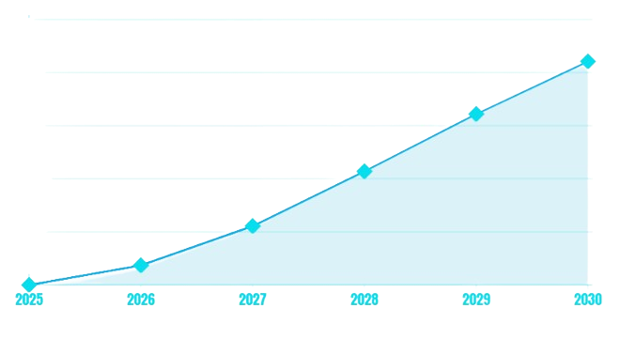

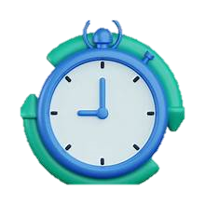

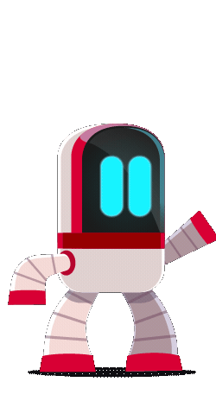

Our Impact
Market Leadership
Global Expansion
130 clinics – 20pts/clinic
1000 fitness players
1850 device sold
Market Expansion
Release AI v3 for advanced features.
75 clinics – 20pts/clinic
750 fitness players
1500 device sold
$143,000/year
Total cost savings for clinics
reducing staff time
$421k
Achieve real-time depth fusion
AI & Hardware v2
35 clinics – 20pts/clinic
500 fitness players
1000 device sold
10,200
hours/year
Total time saved for users
$322k
Expand Clinical Trials
Expand marketing efforts
15 clinics – 20pts/clinic
300 fitness players
600 device sold
$214k
15,400 lives
Total lives directly impacted
Clinical Trials
Regulatory Compliance
5 clinics – 20pts/clinic
100 fitness players
200 device sold
$111k
Product development
Regulatory Compliance
Clinical validation
$37k
Revenue

Slide 8
Our Impact
Our Impact
$1.2T
TAM
$1.02B
SAM
$421k
SOM
Global digital Health Market
Digital Health - EG

Slide 9


What sets Flexi Device Apart
Startup | Online_sessions | AI_based | Clinical integration
Tebcom
Shezlong
Flexi

Slide 10

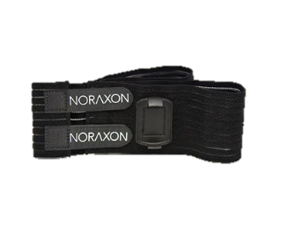
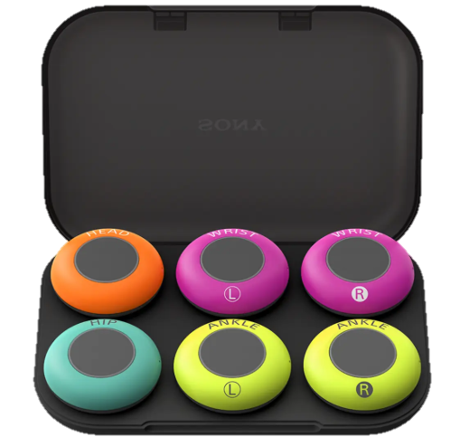
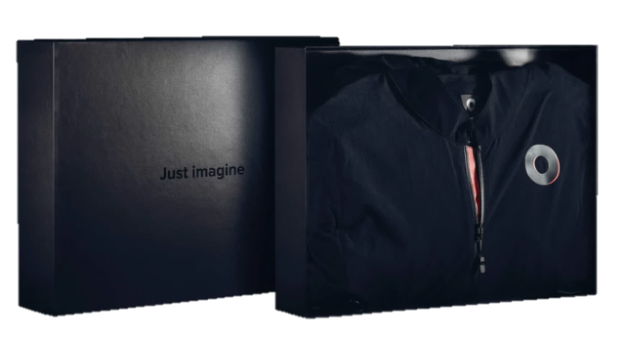
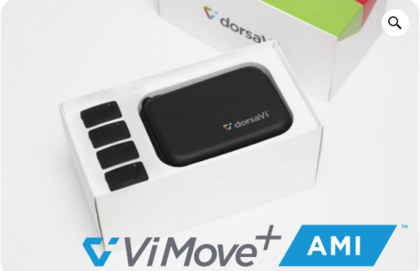
What sets Flexi Device Apart
CareCode
affordable
35 $
30$
For 3d applications
For physical therapy
500$
2300$
250$/month
expensive

Slide 11
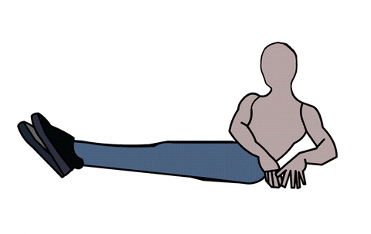
What sets Flexi Device Apart
9/10
Usability

Slide 12
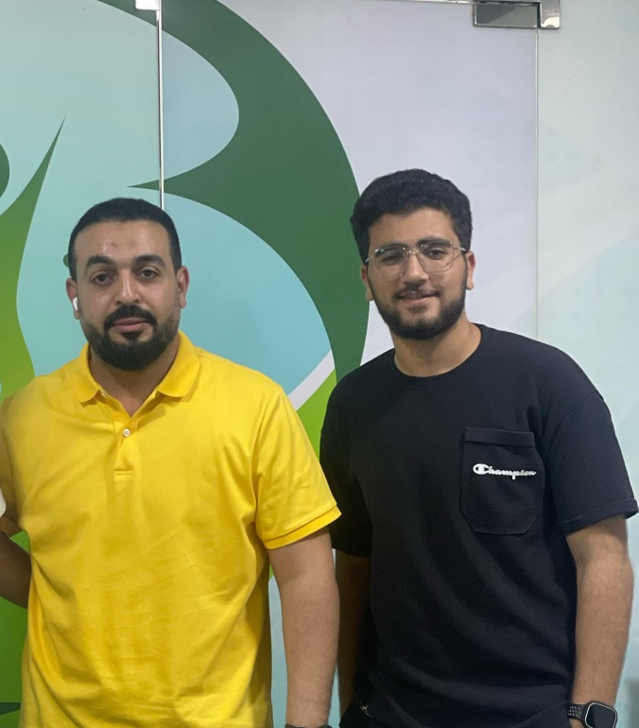
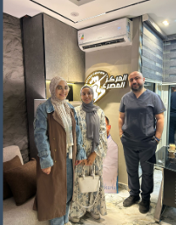


Things We Do
Things We Do

Slide 13

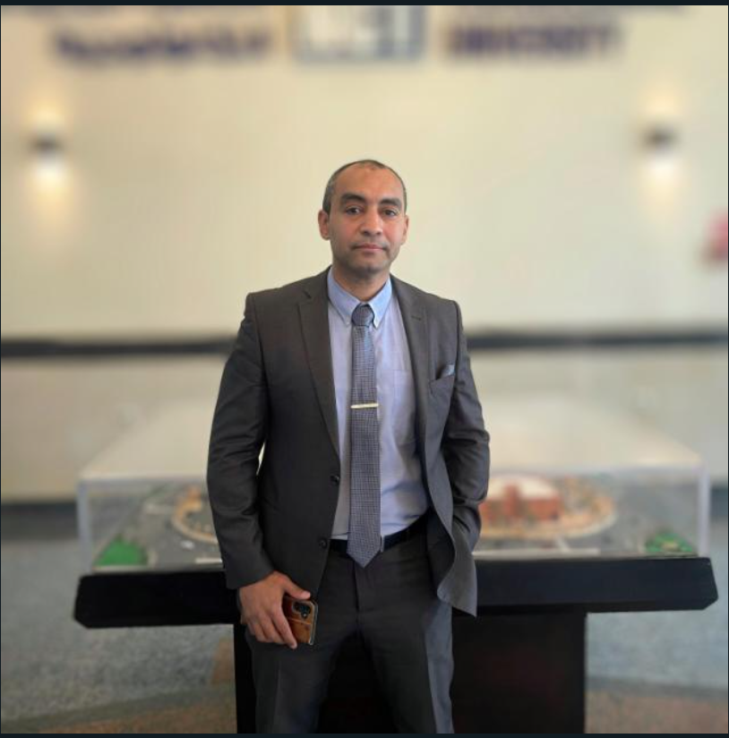
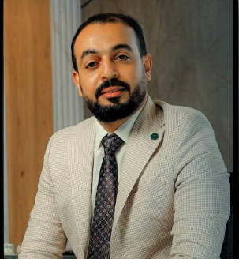


Our Advisors
Support Protocol
Dr. Mohammed Ali Atiea
professor at the Faculty of Computer Science , Suez University , Director of Suez Huawei Academy
Dr.Khaled Badawy
Director of El-Safwa Physiotherapy Centers
Dr. Mohey
professor at the Faculty of Physical Education, Suez University

Slide 14

Goals –
$1M total
Legal
5%
Other
5%
Data Collection
Training AI models
EDA clearance
Manufacturing
Clinical Trials & publications
Regulatory
20%
R&D
55%
Manufacturing
15%

Slide 15
Flexi
Finally;
Our goal is to improve the quality of healthy life as a whole, because every person deserves to live with health, comfort, and self-confidence.

Slide 16
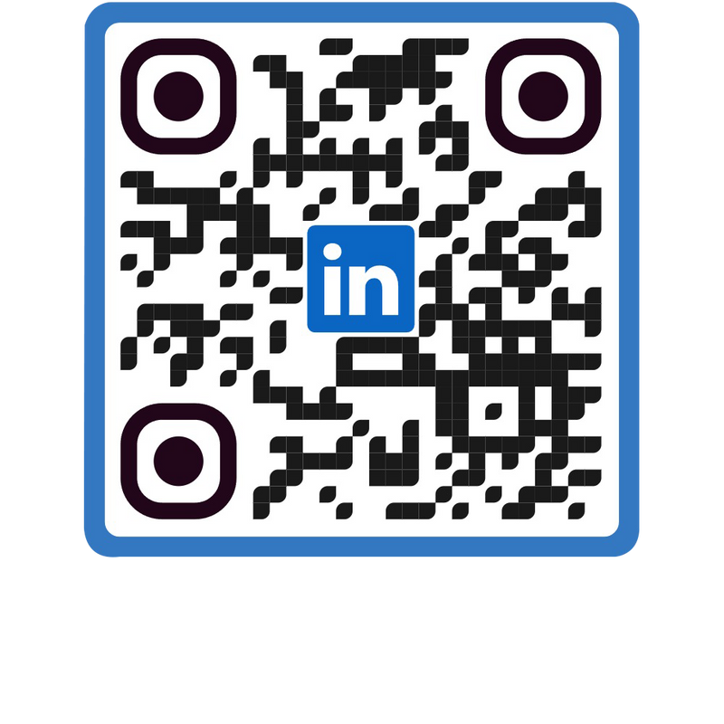
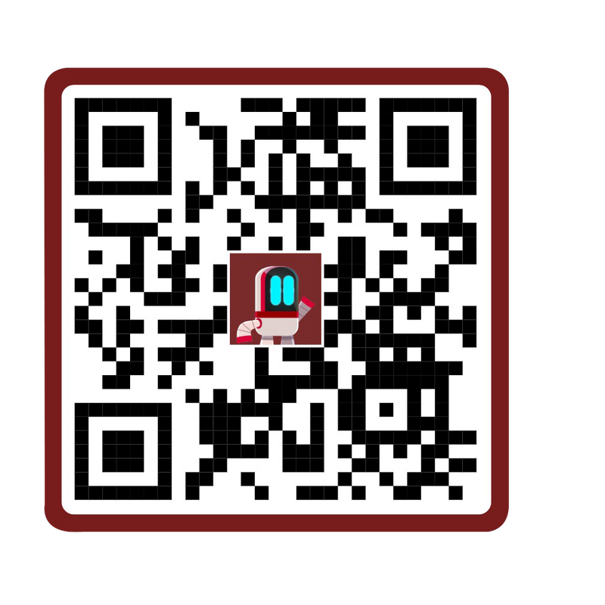
Thank You!
Flexi

